Slide 1
Working with ASP.NET Core Web API

Slide 2
Objectives
Overview Client-server Architecture
Overview ASP.NET Core RESTful Services
Explain about Web Service
Explain about ASP.NET Web API Characteristics
Demo create ASP.NET Core Web API application
Demo create ASP.NET MVC Core Application consume Web API
Demo create WinForms Application consume Web API

Slide 3
Client-server Architecture
Client-server architecture is a computing model in which the server hosts, delivers and manages most ofthe resources and services to be consumed by the client
This type of architecture has one or more client computers connected to a central server over a network or internet connection
Client-server architecture is also known as a networking computing model or client-server network because all the requests and services are delivered over a network

Slide 4
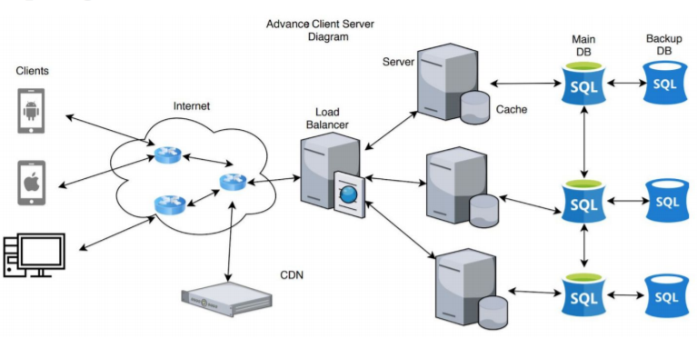
Client-server Architecture
Client requests data from server
Load balancer routes the request to the appropriate server
Server processes the request client
Server queries appropriate database for some data
Database returns the queried data back to the server
The server processes the data and sends the data back to the client
This process repeats

Slide 5
Web Service Acronyms
Web services are services that use the HTTP communication standard, so they are sometimes called HTTP or RESTful services
Web services can also mean Simple Object Access Protocol (SOAP) services that implement some of the WS-* standards
Microsoft .NET Framework 3.0 and later includes a remote procedure call (RPC) technology named Windows Communication Foundation (WCF), which makes it easy for developers to create services including SOAP services that implement WS-* standards
gRPC is a modern cross-platform open source RPC framework created by Google (the "g" in gRPC)

Slide 6
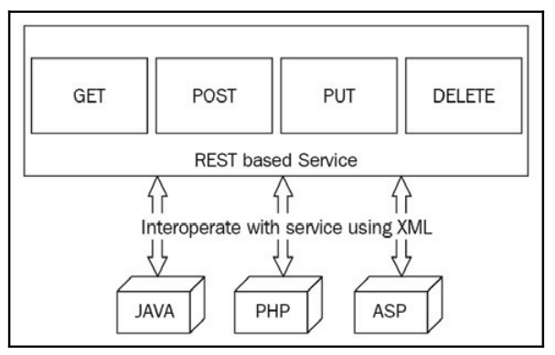
RESTful Services
REST stands for representational state transfer. It is an architectural style that defines a set of guidelines for building web services
The following is a simple diagram of a REST-based service:

Slide 7
ASP.NET Core and RESTful services
ASP.NET Web API from the beginning was designed to be a service-based framework for building RESTful (REpresentational State Transfer) services
ASP.NET Web API is based on the MVC framework minus the “V” (view), with optimizations for creating headless services. These services can be called by any technology
Calls to a Web API service are based on the core HTTP Verbs (Get, Put, Post, Delete) through a URI (Uniform Resource Identifier)
The ASP.NET MVC framework started gaining traction almost immediately, and Microsoft released ASP.NET Web API with ASP.NET MVC 4 and Visual Studio 2012
ASP.NET Web API 2 was released with Visual Studio 2013 and then updated the framework to version 2.2 with Visual Studio 2013 Update 1

Slide 8
ASP.NET Core and RESTful services
ASP.NET Web API is an ideal platform for building RESTful services
ASP.NET Web API is built on top of ASP.NET and supports ASP.NET request/response pipeline
ASP.NET Web API maps HTTP verbs to method names
ASP.NET Web API supports different formats of response data. Built-in support for JSON, XML, BSON format
ASP.NET Web API can be hosted in IIS, Kestrel, Self-hosted or other web server that supports
ASP.NET Core Web API includes new HttpClient to communicate with Web API server. HttpClient can be used in ASP.MVC server side, Windows Form application, Console application or other apps

Slide 9
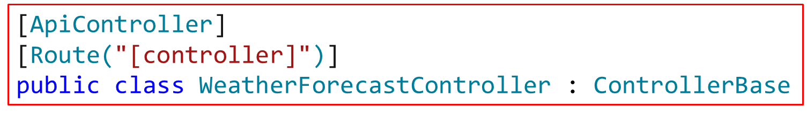
ASP.NET Core and RESTful services
ASP.NET Web API has been built to map the web/HTTP programming model to the .NET Framework programming model. It uses familiar constructs, such as Controller, Action, Filter, and so on, which are used in ASP.NET MVC
ASP.NET Web API is designed on top of the ASP.NET MVC runtime, along with some components that simplify HTTP programming
ASP.NET Core supports creating RESTful services. To handle requests, a web API uses controllers
A Web API consists of one or more controller classes that derive from ControllerBase

Slide 10
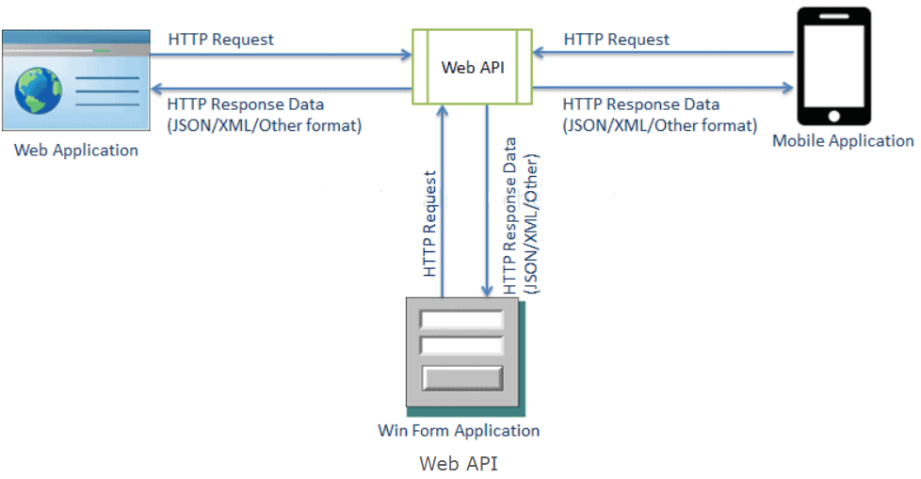

Slide 11
ControllerBase Class
The ControllerBase class provides the core functionality for both ASP.NET Core web applications and services, in addition to helper methods for returning HTTP status codes and properties
Some of the Properties provided by the ControllerBase Class:
Properties | Description
HttpContext | Returns the HttpContext for the currently executing action
Request | Returns the HttpRequest for the currently executing action
Response | Returns the HttpResponse for the currently executing action
ModelState | Returns the state of the model in regard to model binding and validation
Url | Returns an instance of the IUrlHelper, providing access to building URLs for ASP.NET MVC Core applications and services
RouteData | Returns the RouteData for the currently executing action

Slide 12
ControllerBase Class
Some of the Helper Methods provided by the ControllerBase Class:
Method | Notes
BadRequest | Returns 400 status code
NotFound | Returns 404 status code
PhysicalFile | Returns a file
TryUpdateModelAsync | Invokes model binding
TryValidateModel | Invokes model validation
NoContent | Creates a NoContentResult object that produces an empty Status204NoContent response
Ok | Creates a OkResult object that produces an empty Status200OK response
Accepted() | Creates a AcceptedResult object that produces an Status202Accepted response
Content(String) | Creates a ContentResult object by specifying a content string

Slide 13
Request and Response
A REST request generally consists of the following:
HTTP verb: This denotes what kind of operation the requests want to perform on the server
Header: This element of the REST request allows the client to pass more information about the request
URL: The actual path to the resource that the REST request wants to operate on
Body: The body can contain extra data related to a resource to identify or update it. This is optional though

Slide 14
HTTP verbs
The following are basic HTTP verbs used while requesting a REST system for resource interaction:
GET: Used to retrieve a specific resource by its identity or a collection of resources
POST: Used to create/insert a new resource
PUT: Used to update a specific resource by its identity
DELETE: Used to remove a specific resource by its identity

Slide 15
Status Code
When a server returns responses, it includes status codes. These status codes inform the client how the request performed on the server
Status | Code Explanation
200 | OK Standard response for successful HTTP requests
201 | CREATED Standard response for an HTTP request when an item is successfully
204 | NO CONTENT Standard response for successful HTTP requests, if nothing is returned in the response body
400 BAD REQUEST | Request cannot be processed because of bad request syntax, excessive size, or another client error
403 FORBIDDEN | Client does not have permission to access the requested resource
404 NOT FOUND | Resource could not be found at this time. It might have been deleted, or does not exist yet
500 INTERNAL SERVER ERROR | This response comes whenever there is a failure or exception happens while processing the server side codes

Slide 16
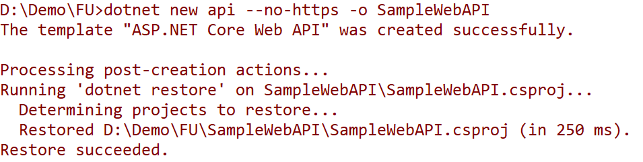
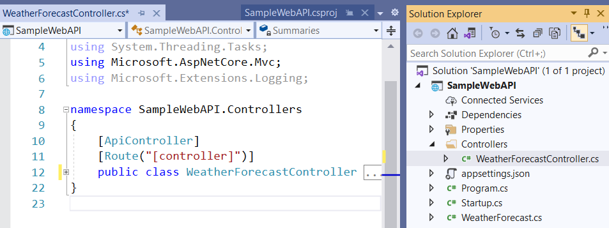
Create Web API by dotnet CLI
A web API sample
Open SampleWebAPI project by Visual Studio

Slide 17
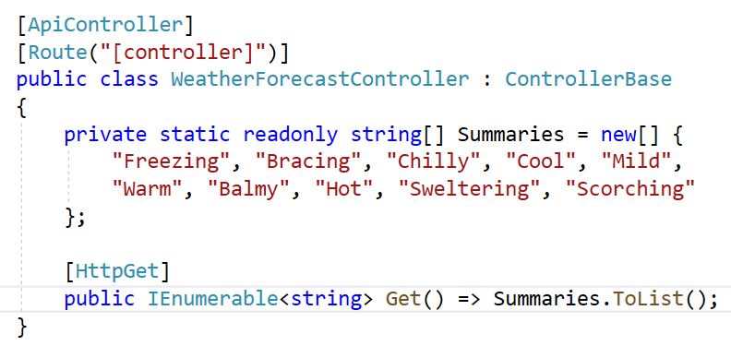
A web API sample
Update codes of the WeatherForecastController.cs as follows:

Slide 18
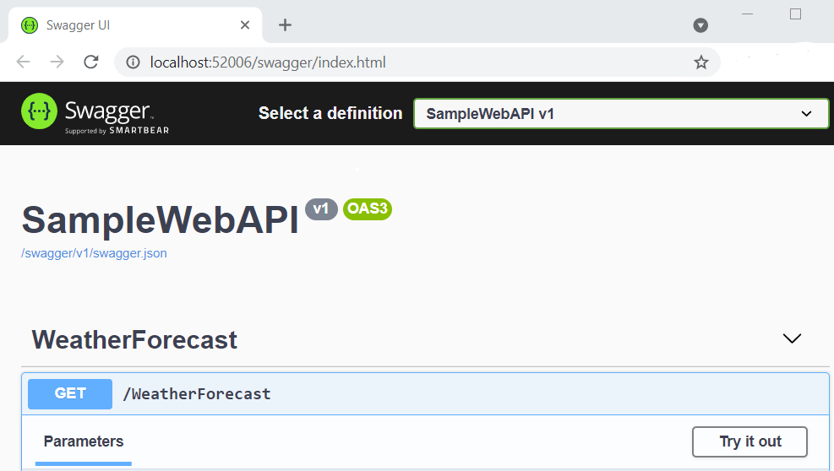
A web API sample
Run project to test Get method by Swagger
1
2

Slide 19
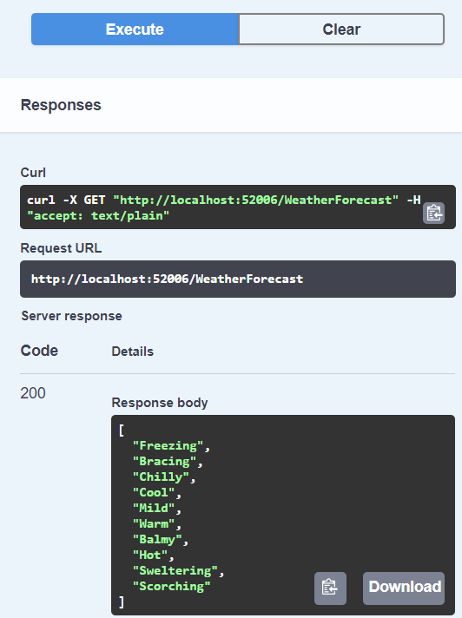
3

Slide 20
ASP.NET Core attributes
The Microsoft.AspNetCore.Mvc namespace provides attributes that can be used to configure the behavior of web API controllers and action methods
The following example uses attributes to specify the supported HTTP action verb and any known HTTP status codes that could be returned:
[HttpPost]
[ProducesResponseType(StatusCodes.Status201Created)] [ProducesResponseType(StatusCodes.Status400BadRequest)]
public ActionResult<Product> Create(Product product)
{
//………
return CreatedAtAction(nameof(GetById), new { id = product.Id }, product);
}

Slide 21
ASP.NET Core attributes
Some more examples of attributes that are available:
Method | Notes
HttpPostAttribute | Identifies an action that supports the HTTP POST method
HttpPutAttribute | Identifies an action that supports the HTTP PUT method
HttpDeleteAttribute | Identifies an action that supports the HTTP DELETE method
HttpGetAttribute | Identifies an action that supports the HTTP GET method
RouteAttribute | Specifies an attribute route on a controller
HttpHeadAttribute | Identifies an action that supports the HTTP HEAD method
HttpOptionsAttribute | Identifies an action that supports the HTTP OPTIONS method
HttpPatchAttribute | Identifies an action that supports the HTTP PATCH method
More attributes: https://docs.microsoft.com/en-us/dotnet/api/microsoft.aspnetcore.mvc?view=aspnetcore-5.0

Slide 22
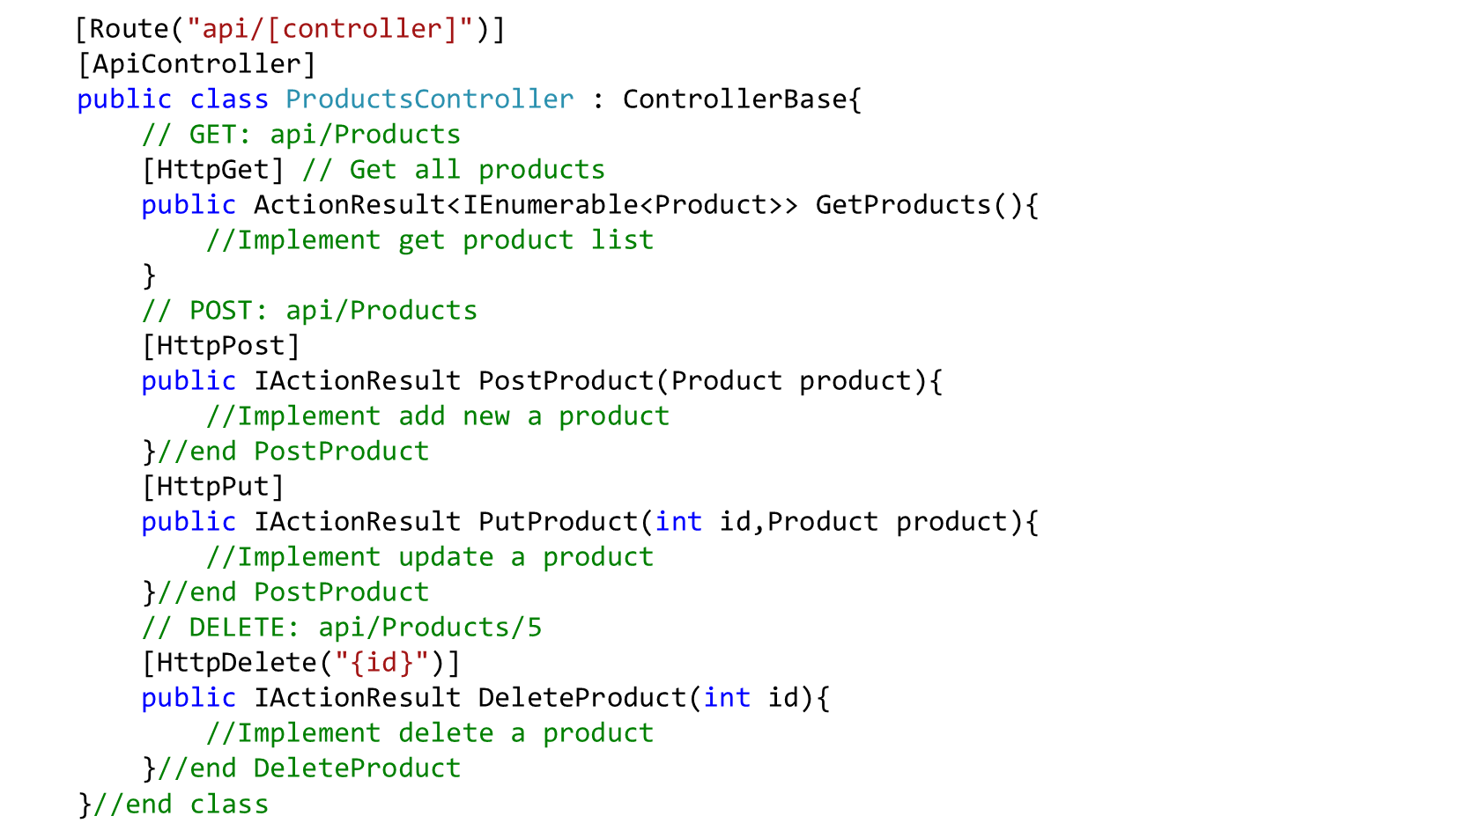
ASP.NET Core attributes

Slide 23
Binding Source Parameter Inference
A binding source attribute defines the location at which an action parameter's value is found
The following binding source attributes exist:
Attribute | Binding source
[FromBody] | Inferred for complex types. Only one FromBody parameter can exist or an exception will be thrown. Exceptions exist for IFormCollection and CancellationToken
[FromForm] | Inferred for action parameters of type IFormFile and IFormFileCollection. When parameter is marked with FromForm, the multipart/form-data content type is inferred
[FromHeader] | Request header
[FromQuery] | Inferred for any other action parameters
[FromRoute] | Inferred for any parameter name that matches a route token name
[FromServices] | The request service injected as an action parameter

Slide 24
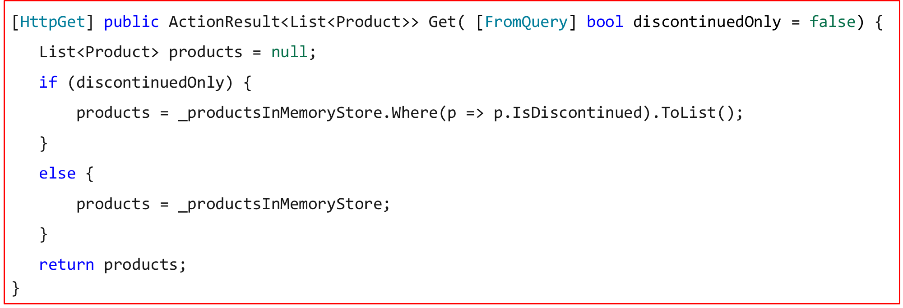
Binding Source Parameter Inference

Slide 25
Demo 01- Create a Web API Application

Slide 26
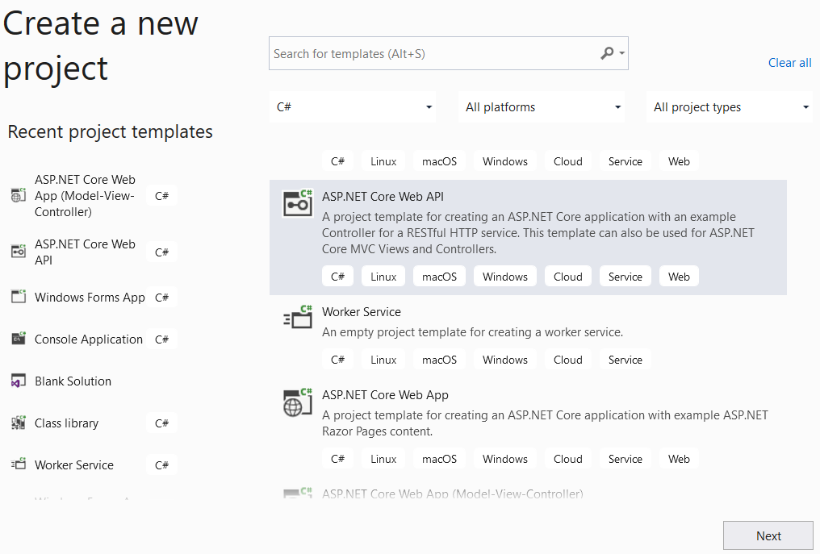
1. Open Visual Studio.NET , File | New | Project
1
2

Slide 27
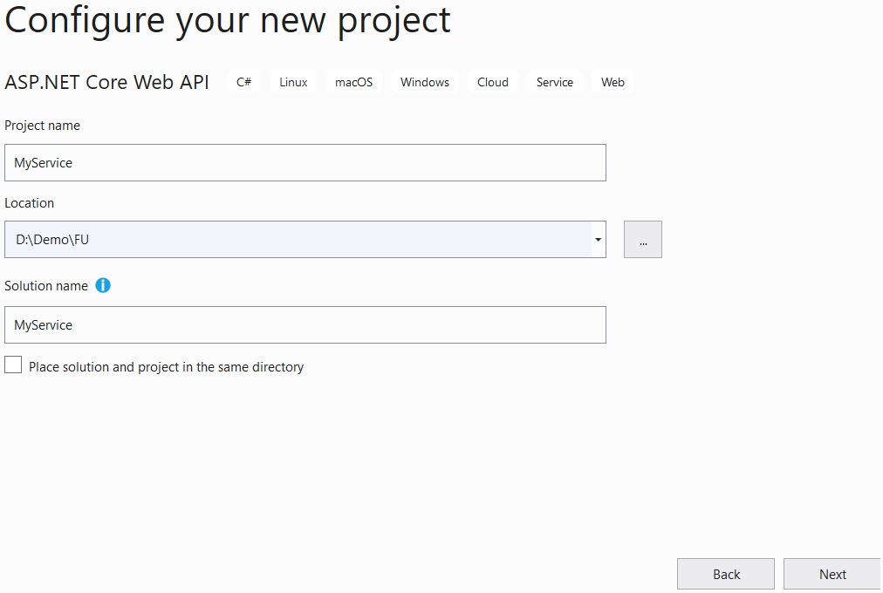
2. Fill out Project name: MyWebApp and Location then click Next
3
4
5

Slide 28
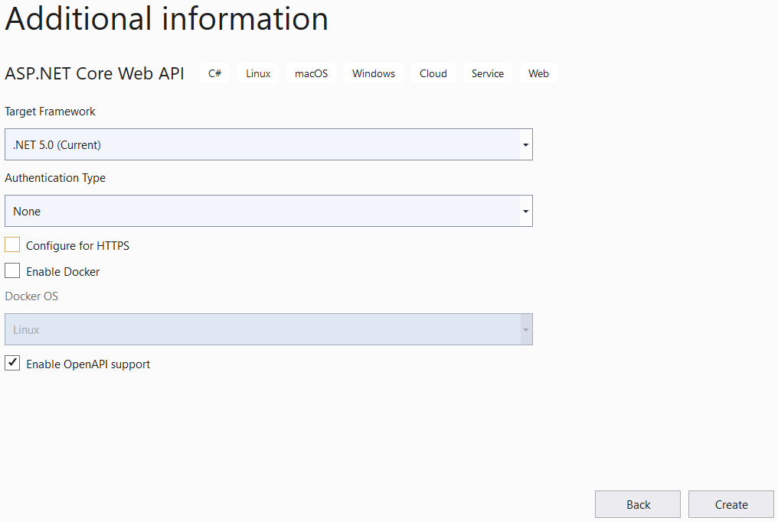
3. Config as follows then click Create
6
7
8
4. Install the package Microsoft.EntityFrameworkCore.InMemory from Nuget

Slide 29
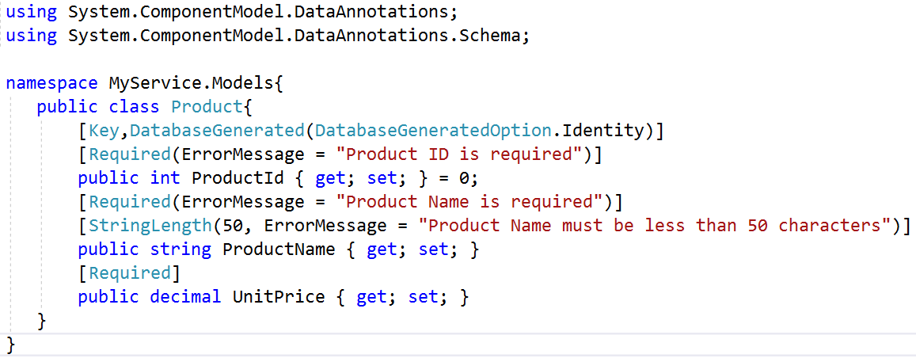
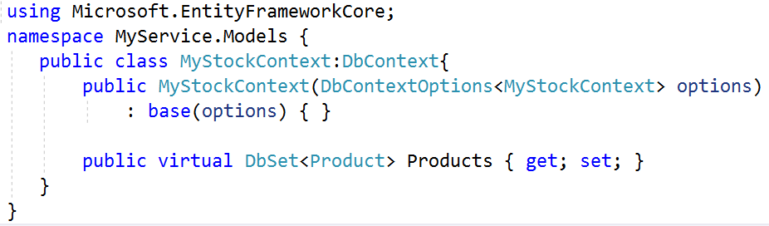
5.Right-click on Models folder | Add | Class, named Product.cs and a class named MyStockContext.cs then write codes as follows:
Product.cs
MyStockContext.cs

Slide 30
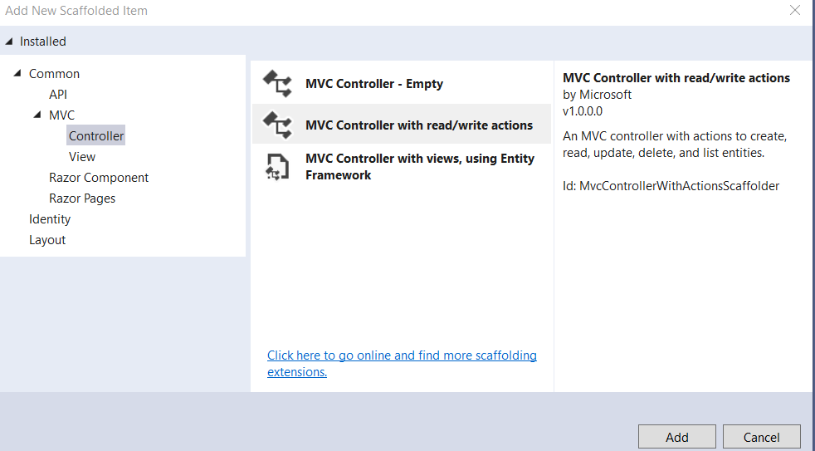
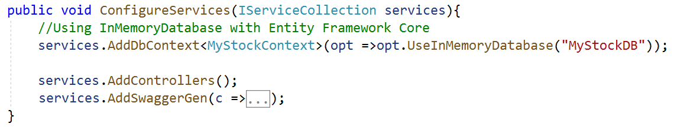
6.Right-click on Controller folder | Add | Controller, named ProductsController.cs
7.Open Startup.cs and update code for ConfigureService method as follows:
//add two namespaces
using MyService.Models;
using Microsoft.EntityFrameworkCore;
//…

Slide 31
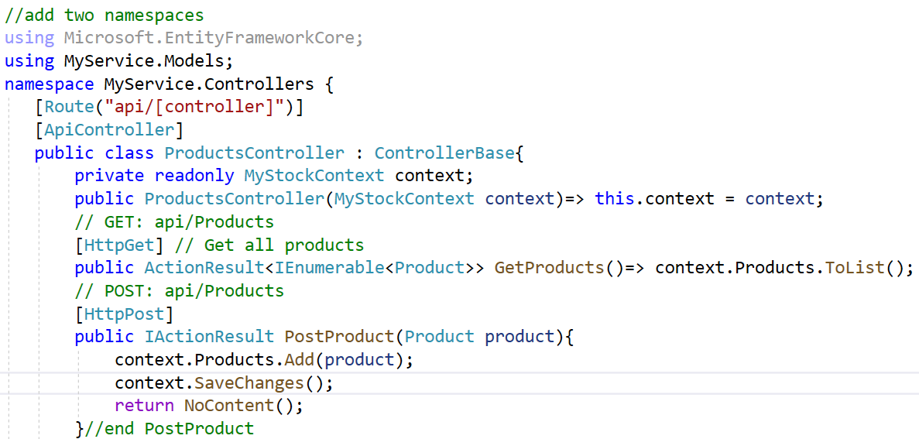
8.Write codes for ProductsController.cs as follows

Slide 32
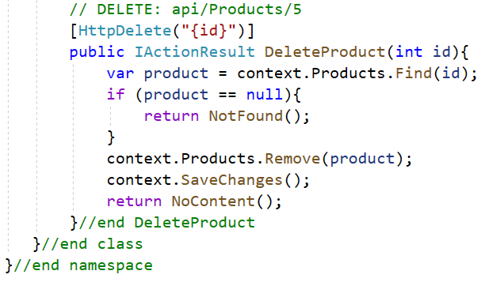
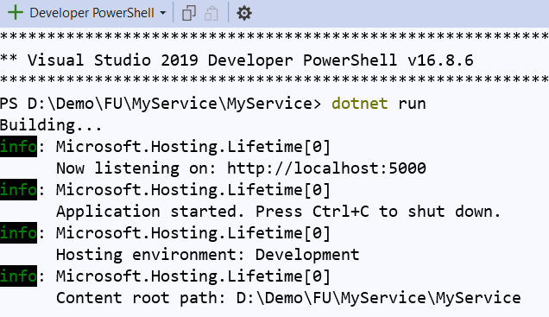
9.Right-click on the project, select Open in Terminal. On Developer PowerShell dialog, execute the following command to run Web API project:

Slide 33
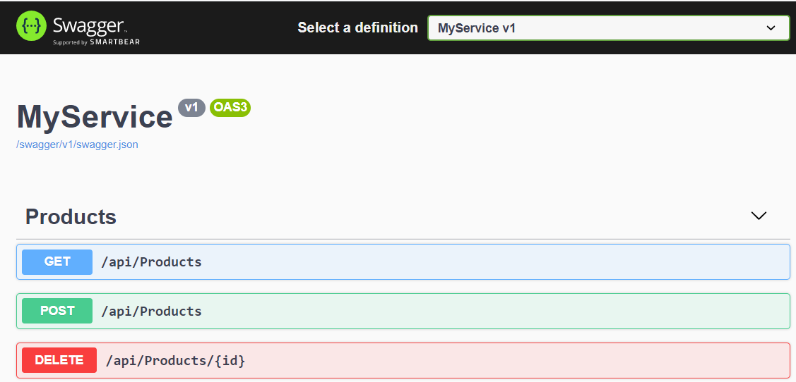
10.Open the web browser and go to link to test action methods with Swagger : http://localhost:5000/swagger/index.html

Slide 34
Demo 02- Create a ASP.NET MVC Core Application to consume Web API

Slide 35
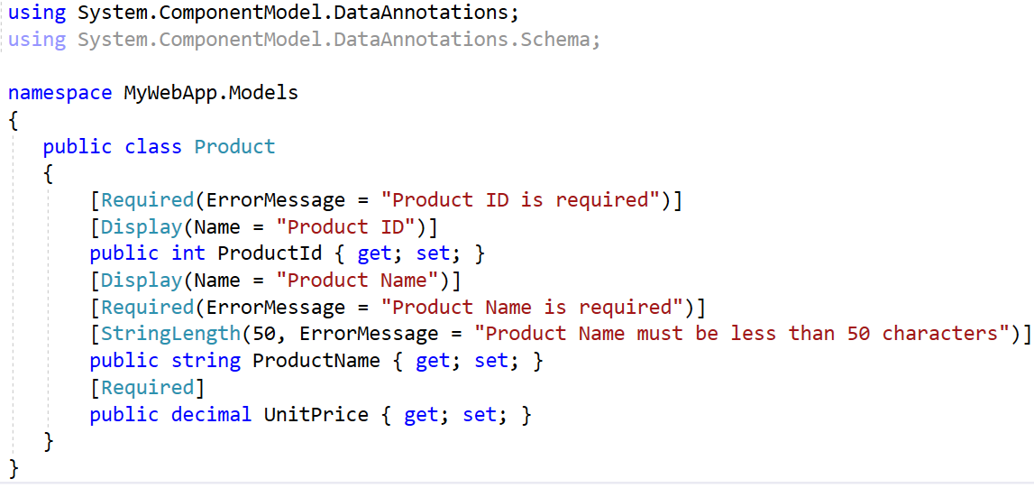
2.Right-click on Models folder | Add | Class, named Product.cs and write codes as follows:
1.Create a ASP.NET MVC Core application named MyWebApp

Slide 36
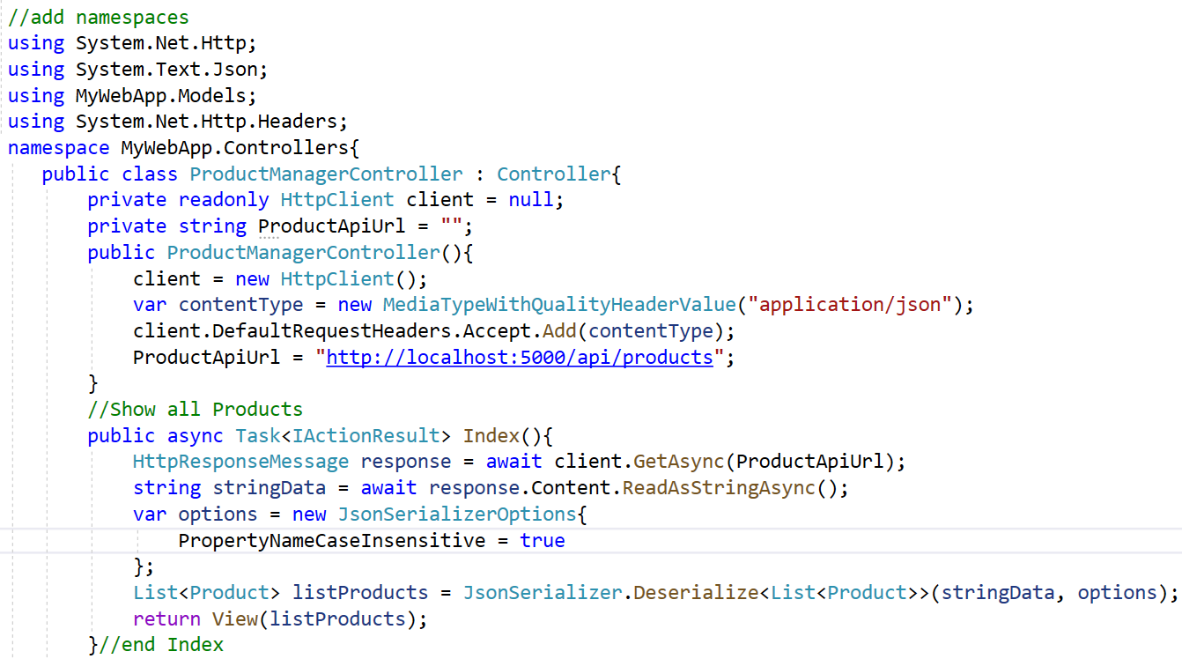
3.Right-click on Controllers folder | Add | Controller named ProductManagerController.cs and write codes as follows:

Slide 37
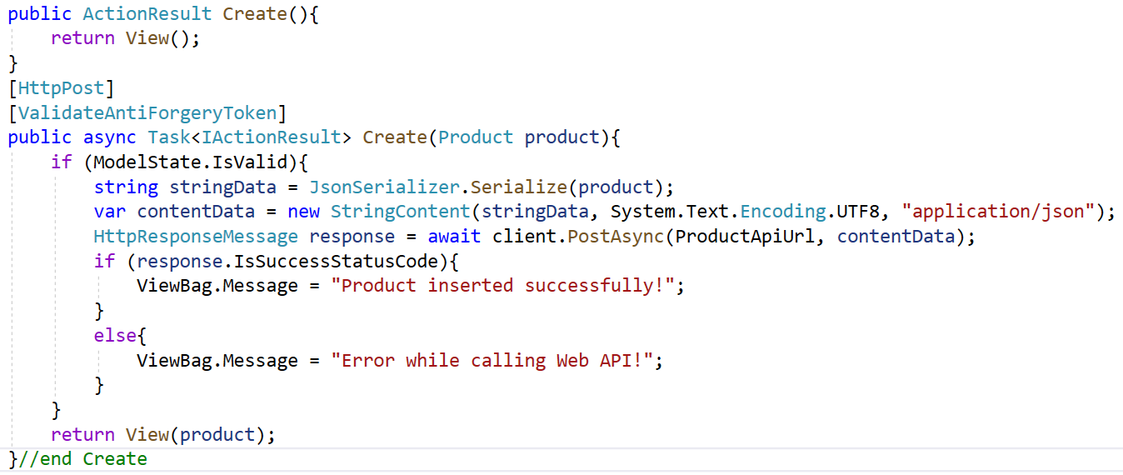
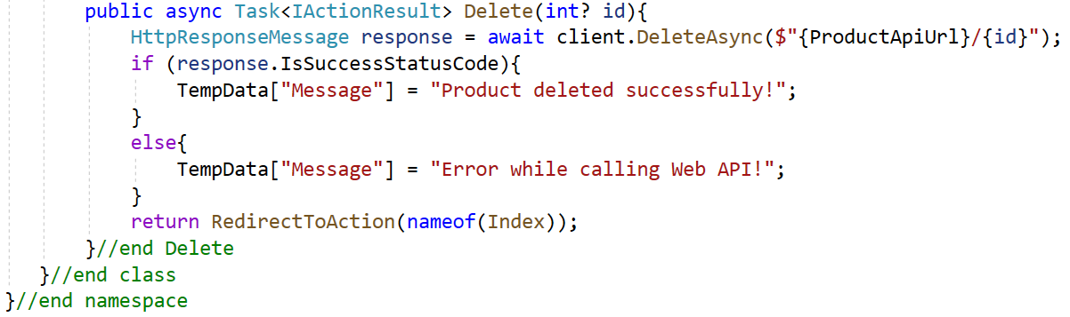

Slide 38
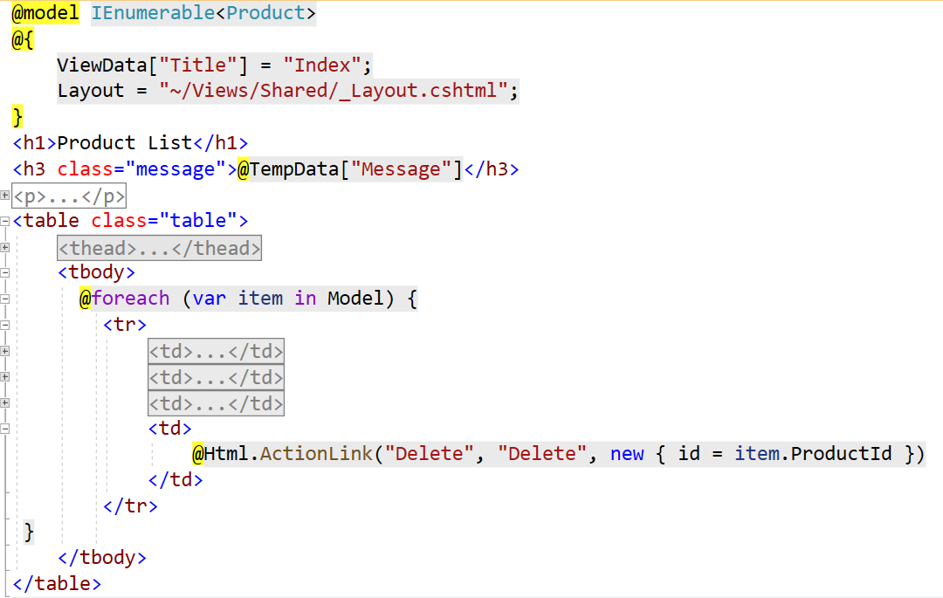
4.Right-click on View folder | Add | New Folder named ProductManager
5.Right-click on ProductManager folder | Add | View named Index (List) to display product list then update codes as follows:

Slide 39
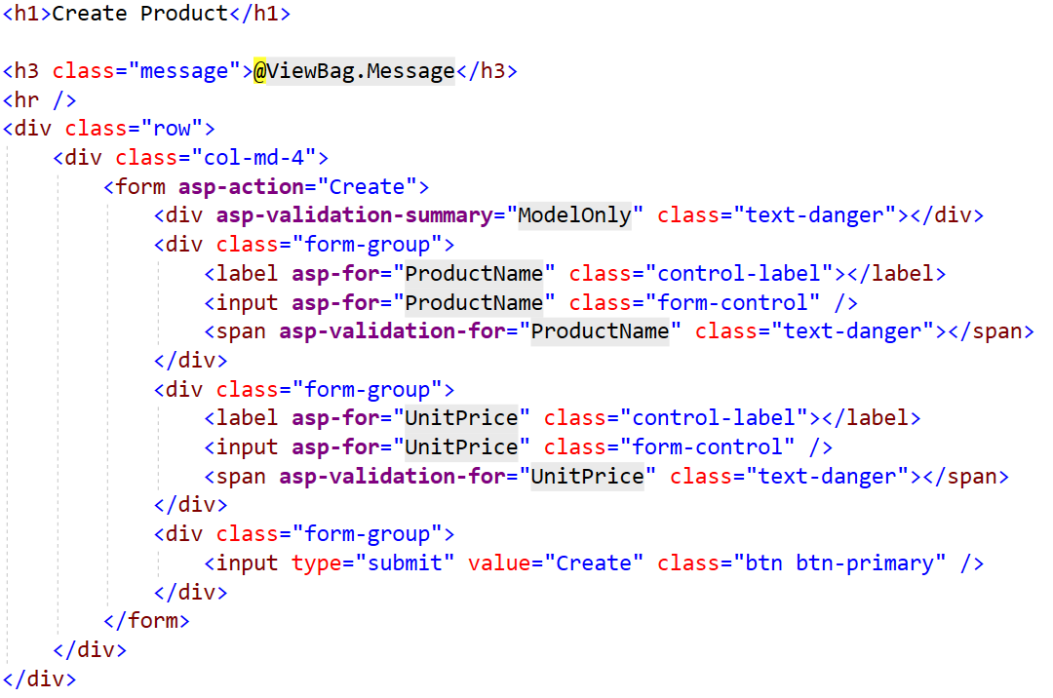
Repeat this step to add views: Create as the below figure:

Slide 40
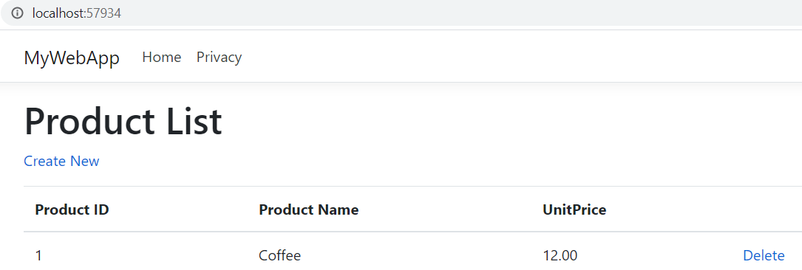
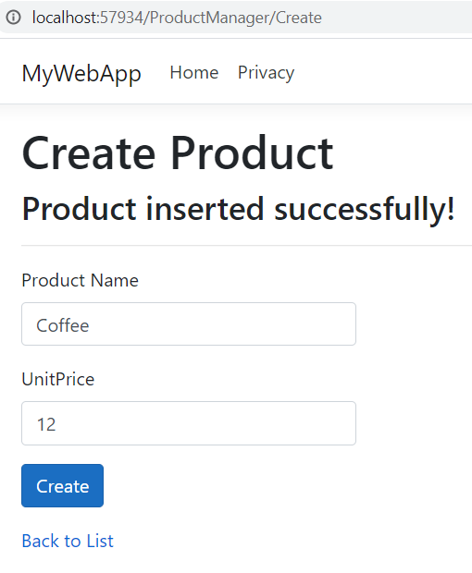
6.Run MyService project (reference to Step 9 of Demo-01) then run MyWebApp project

Slide 41
Demo 03- Create a Windows Forms Application to consume Web API

Slide 42
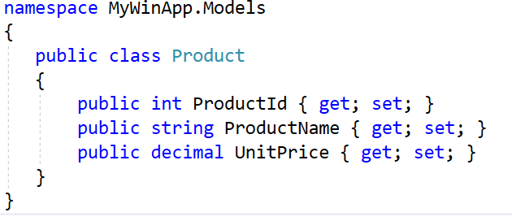
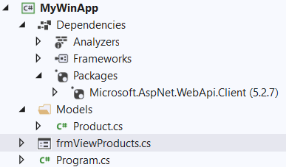
3. Right-click on the project add a folder named Models then add into this folder a class named Product.cs and write codes as follows:
1.Create a Windows Forms application named MyWinApp
2. Install the package Microsoft.AspNet.WebApi.Client from Nuget

Slide 43
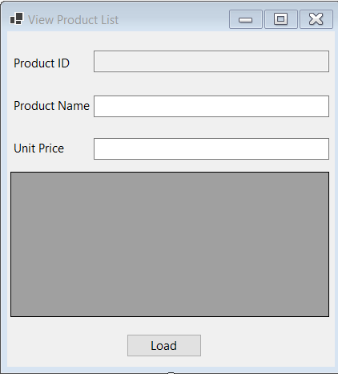
4. Create a form named frmViewProducts has UI as follows:
Object Type | Object name | Properties / Events
Label | lbProductID | Text: Product ID
Label | lbProductName | Text: Product Name
Label | lbUnitPrice | Text: Unit Price
TextBox | txtProductID | ReadOnly: True
TextBox | txtProductName
TextBox | txtUnitPrice
Button | btnLoad | Text: Delete Event Handler: Click
DataGridView | dgvProductList | ReadOnly: True SelectionMode:FullRowSelect
Form | frmViewProducts | StartPosition: CenterScreen Text: View Product List

Slide 44
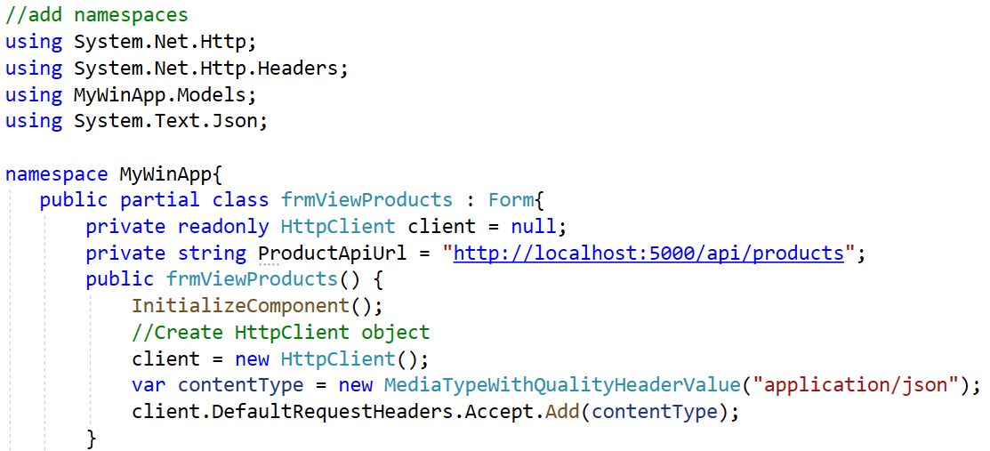
5. Write codes in the frmViewProducts.cs as follows and run project:

Slide 45
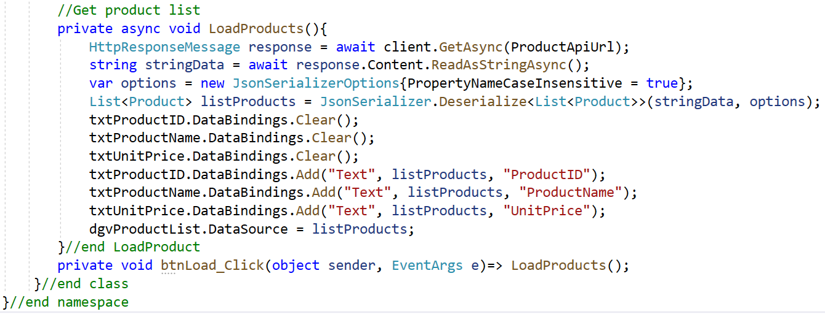
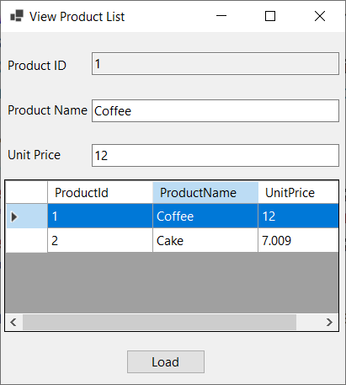

Slide 46
Lab and Assigment
1. Do Hands-on Lab: Lab_03_AutomobileManagement_Using_ASP.NET MVC and EF Core.pdf 2. Do Assigment: Assignment_03_eStoreManagement.pdf

Slide 47
Summary
Concepts were introduced:
Overview Client-server Architecture
Overview ASP.NET Core and RESTful Services
Explain about Web Service
Explain about ASP.NET Web API Characteristics
Demo create ASP.NET Core Web API application
Demo create ASP.NET MVC Core Application consume Web API
Demo create WinForms Application consume Web API

